Slide 1
The State of Serverless
Richie Rump, Dataveloper

Slide 2


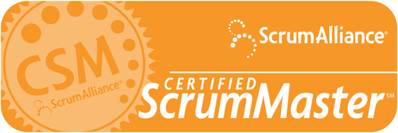
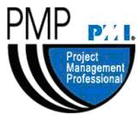


Who Am I?

Slide 3

My Clique

Slide 4
Agenda
What is Serverless?
How does Serverless work?
Why should you care?
Serverless in Amazon Web Services
Serverless in Azure
Things I wish I knew when I started

Slide 5
Cloud Abstractions
Infrastructure as a Service (IaaS) — Amazon EC2, Azure VMs
Containers as a Service (CaaS) — Docker Cloud, Amazon ECS, Azure Container Service
Platform as a Service (PaaS) — Heroku, Amazon Elastic Beanstalk, Azure Service Fabric
Function as a Service (FaaS) — AWS Lambda, Google Cloud Functions, Azure Functions
Software as a Service (SaaS) – Salesforce, Office 365

Slide 6
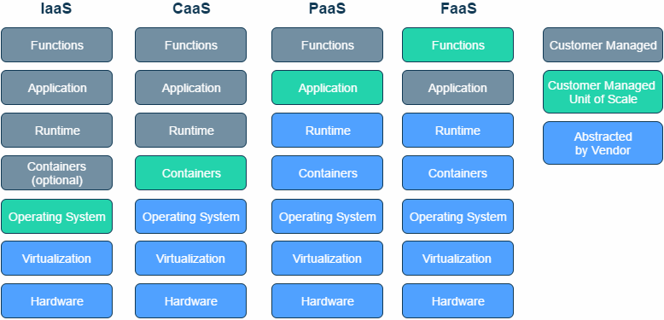
Hijacked from Serverless.Zone: https://serverless.zone/abstracting-the-back-end-with-faas-e5e80e837362

Slide 7

Traditional Web Architecture
Browser
Web Server
Logic
Database

Slide 8
Typical Serverless web application
API
Function
Browser
Storage
Database

Slide 9
What is Serverless?

Slide 10

Notes:
You can’t run code without servers.

Slide 11
THERE ARE SERVERS IN SERVERLESS
Notes:
Functions as a service

Slide 12
What is Serverless?
A cloud computing execution model where the cloud provider fully manages (virtual) servers behind the scenes.

Slide 13
Why should you care?
No servers to configure

Slide 14
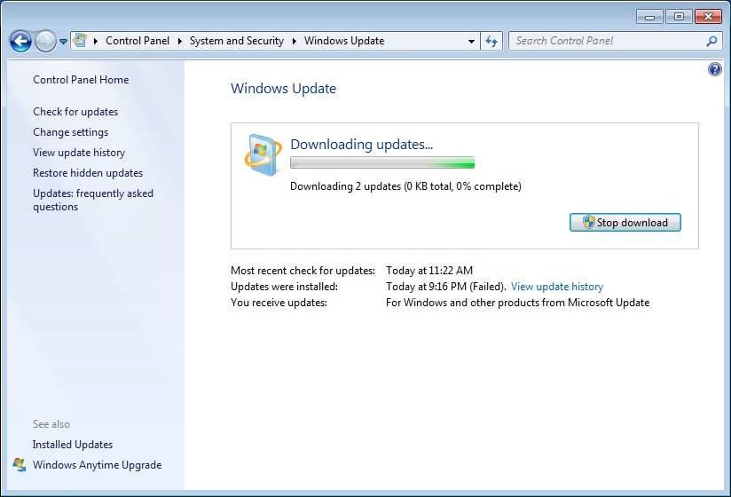

Slide 15
Why should you care?
No VMs to spin up
Notes:
You don’t need to wait for a VM to be configured and start.

Slide 16
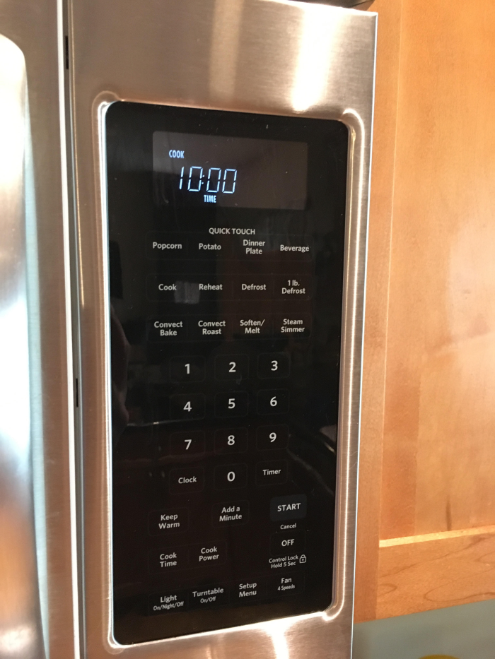
Notes:
You don’t need to wait for a VM to be configured and start.

Slide 17
Why should you care?
No framework required
Notes:
Everything required to run is in the service. If you need an additional framework and it’s not provided then you can’t use Serverless.

Slide 18
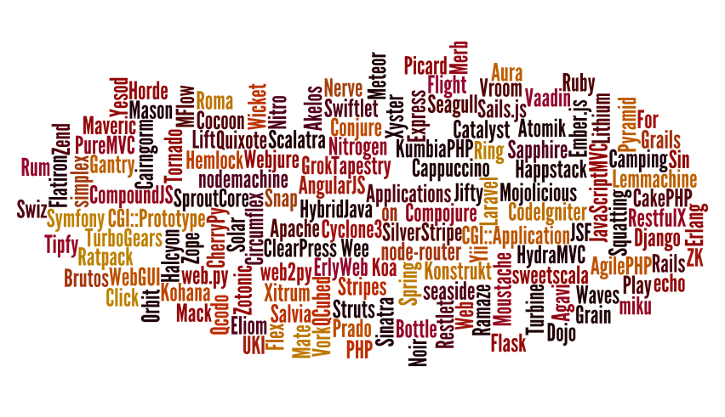
Image: http://hillfold.com/wp-content/uploads/2015/01/webFrameworksCloud.png

Slide 19
Why should you care?
Automatic scaling
Notes:
The Serverless service is in charge of the hardware

Slide 20

Image: http://exposure.vc/wp-content/uploads/2015/07/server-1080x675.jpg

Slide 21
Why should you care?
Multiple triggers
Notes:
Function can be called automatically by other cloud services.

Slide 22
Why should you care?
Reduced cost

Slide 23
Why should you care?
Cost
Number of executions
Execution duration

Slide 24
What’s not so great
Vendor lock-in
Vendor control
Poor debugging story
Lack of integration testing tooling
Deployment
No state management

Slide 25
Serverless in Microsoft Azure
Storage: Blob Storage
Function: Azure Functions
API: Azure Functions Proxies (Beta)
Database:
SQL Database (Relational)
DocumentDB (NoSQL)

Slide 26
Azure Functions - Languages
C#
Node.js
F#
Python
PHP
Bash
Batch
PowerShell

Slide 27
Azure Functions - Triggers
Storage Blob
Webhook (GitHub!)
HTTP
Queue
Timer
Service Bus
Document DB
Table
Mobile Apps
Event Hub
Notification Hub
Twilio

Slide 28
Azure Functions - Integrations
DocumentDB
Storage (blob, queues, topics)
Event Hubs
Mobile Apps (tables)
Notification Hubs
Service Bus (queues, topics)
GitHub
On-premises (using Service Bus)

Slide 29
Azure Functions
DEMO

Slide 30
Compare!
Azure Functions
Security using keys
Language-palooza
Outputs
AWS Lambda
Security using roles
Java
VPC

Slide 31
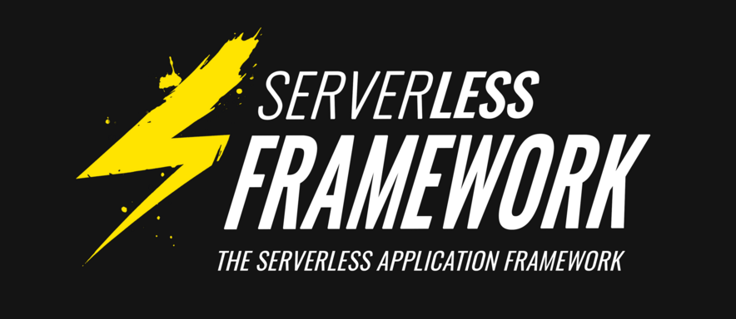
Serverless.com

Slide 32
What I wish I knew…
Security
Use a deployment tool (i.e. Serverless)
Script out cloud resources
Use Microservice Architecture concepts
Keep a cloud mindset
Plan for failures
Degradation
Request buffering
Notes:
Principal of least privilege.

Slide 33
Contact
Richie Rump
@Jorriss
http://jorriss.net
http://awayfromthekeyboard.com
http://dotnetmiami.com
http://brentozar.com

Slide 34
Thank You!

